Slide 2
What will we learn about in this class?
World Geography focuses on 1 time period, 5 different regions of the world, and 4 major themes…
Most of all, you will discover…
Why the world today is the way it is.

Slide 3
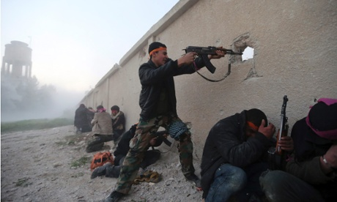
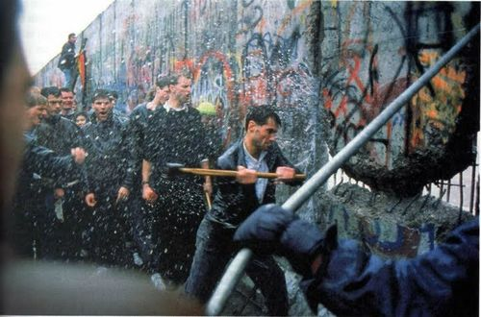
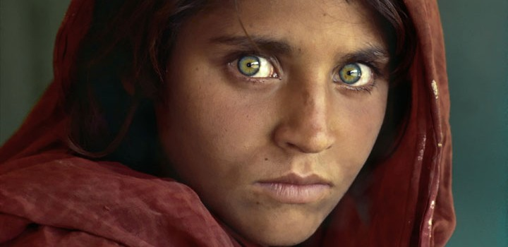
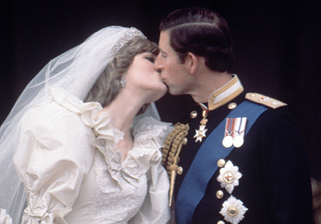
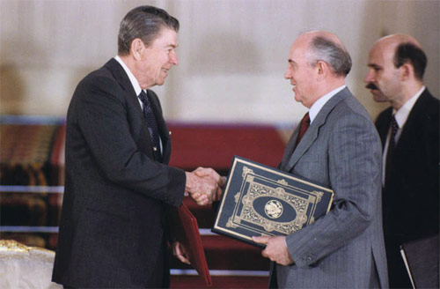
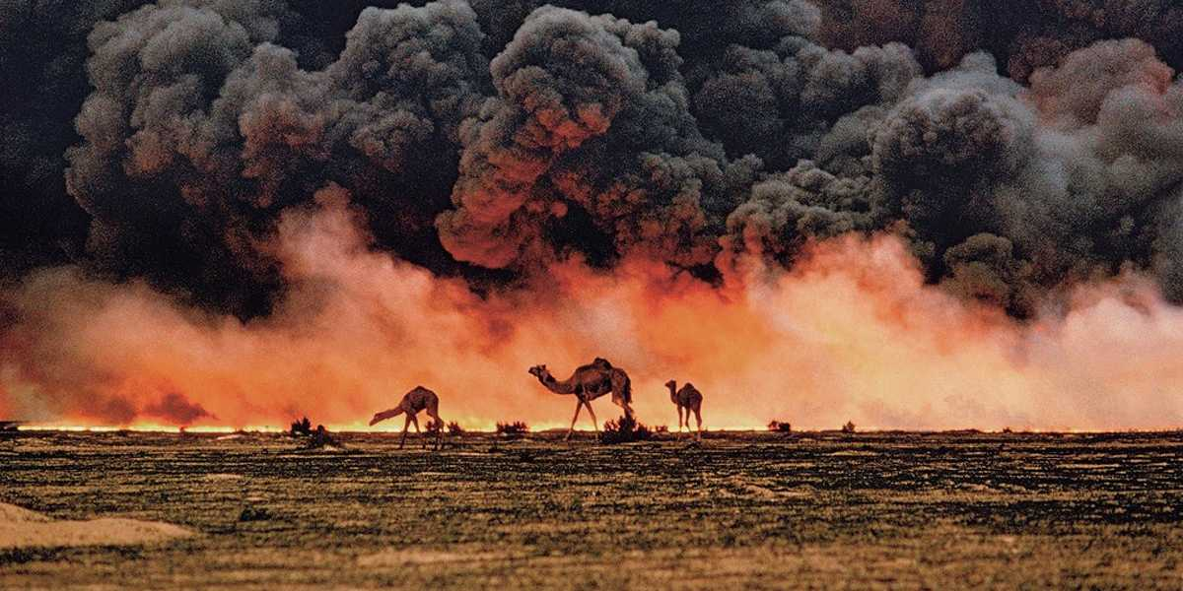
What is happening in the world today?

Slide 4
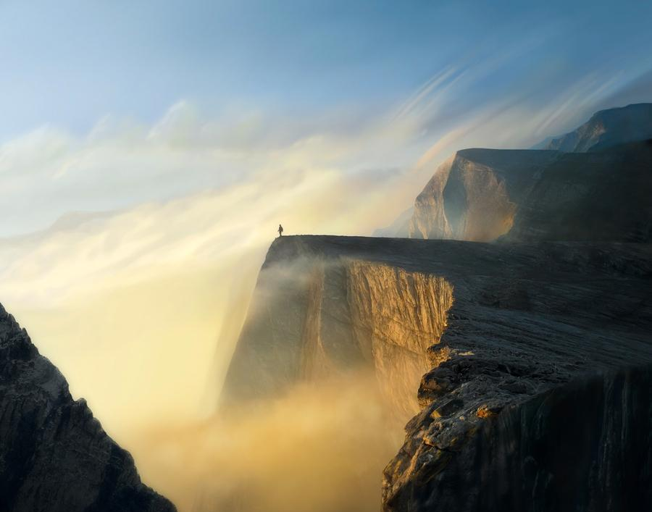
We live on an amazing planet…

Slide 5
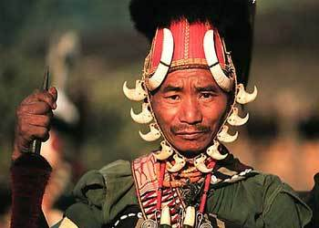
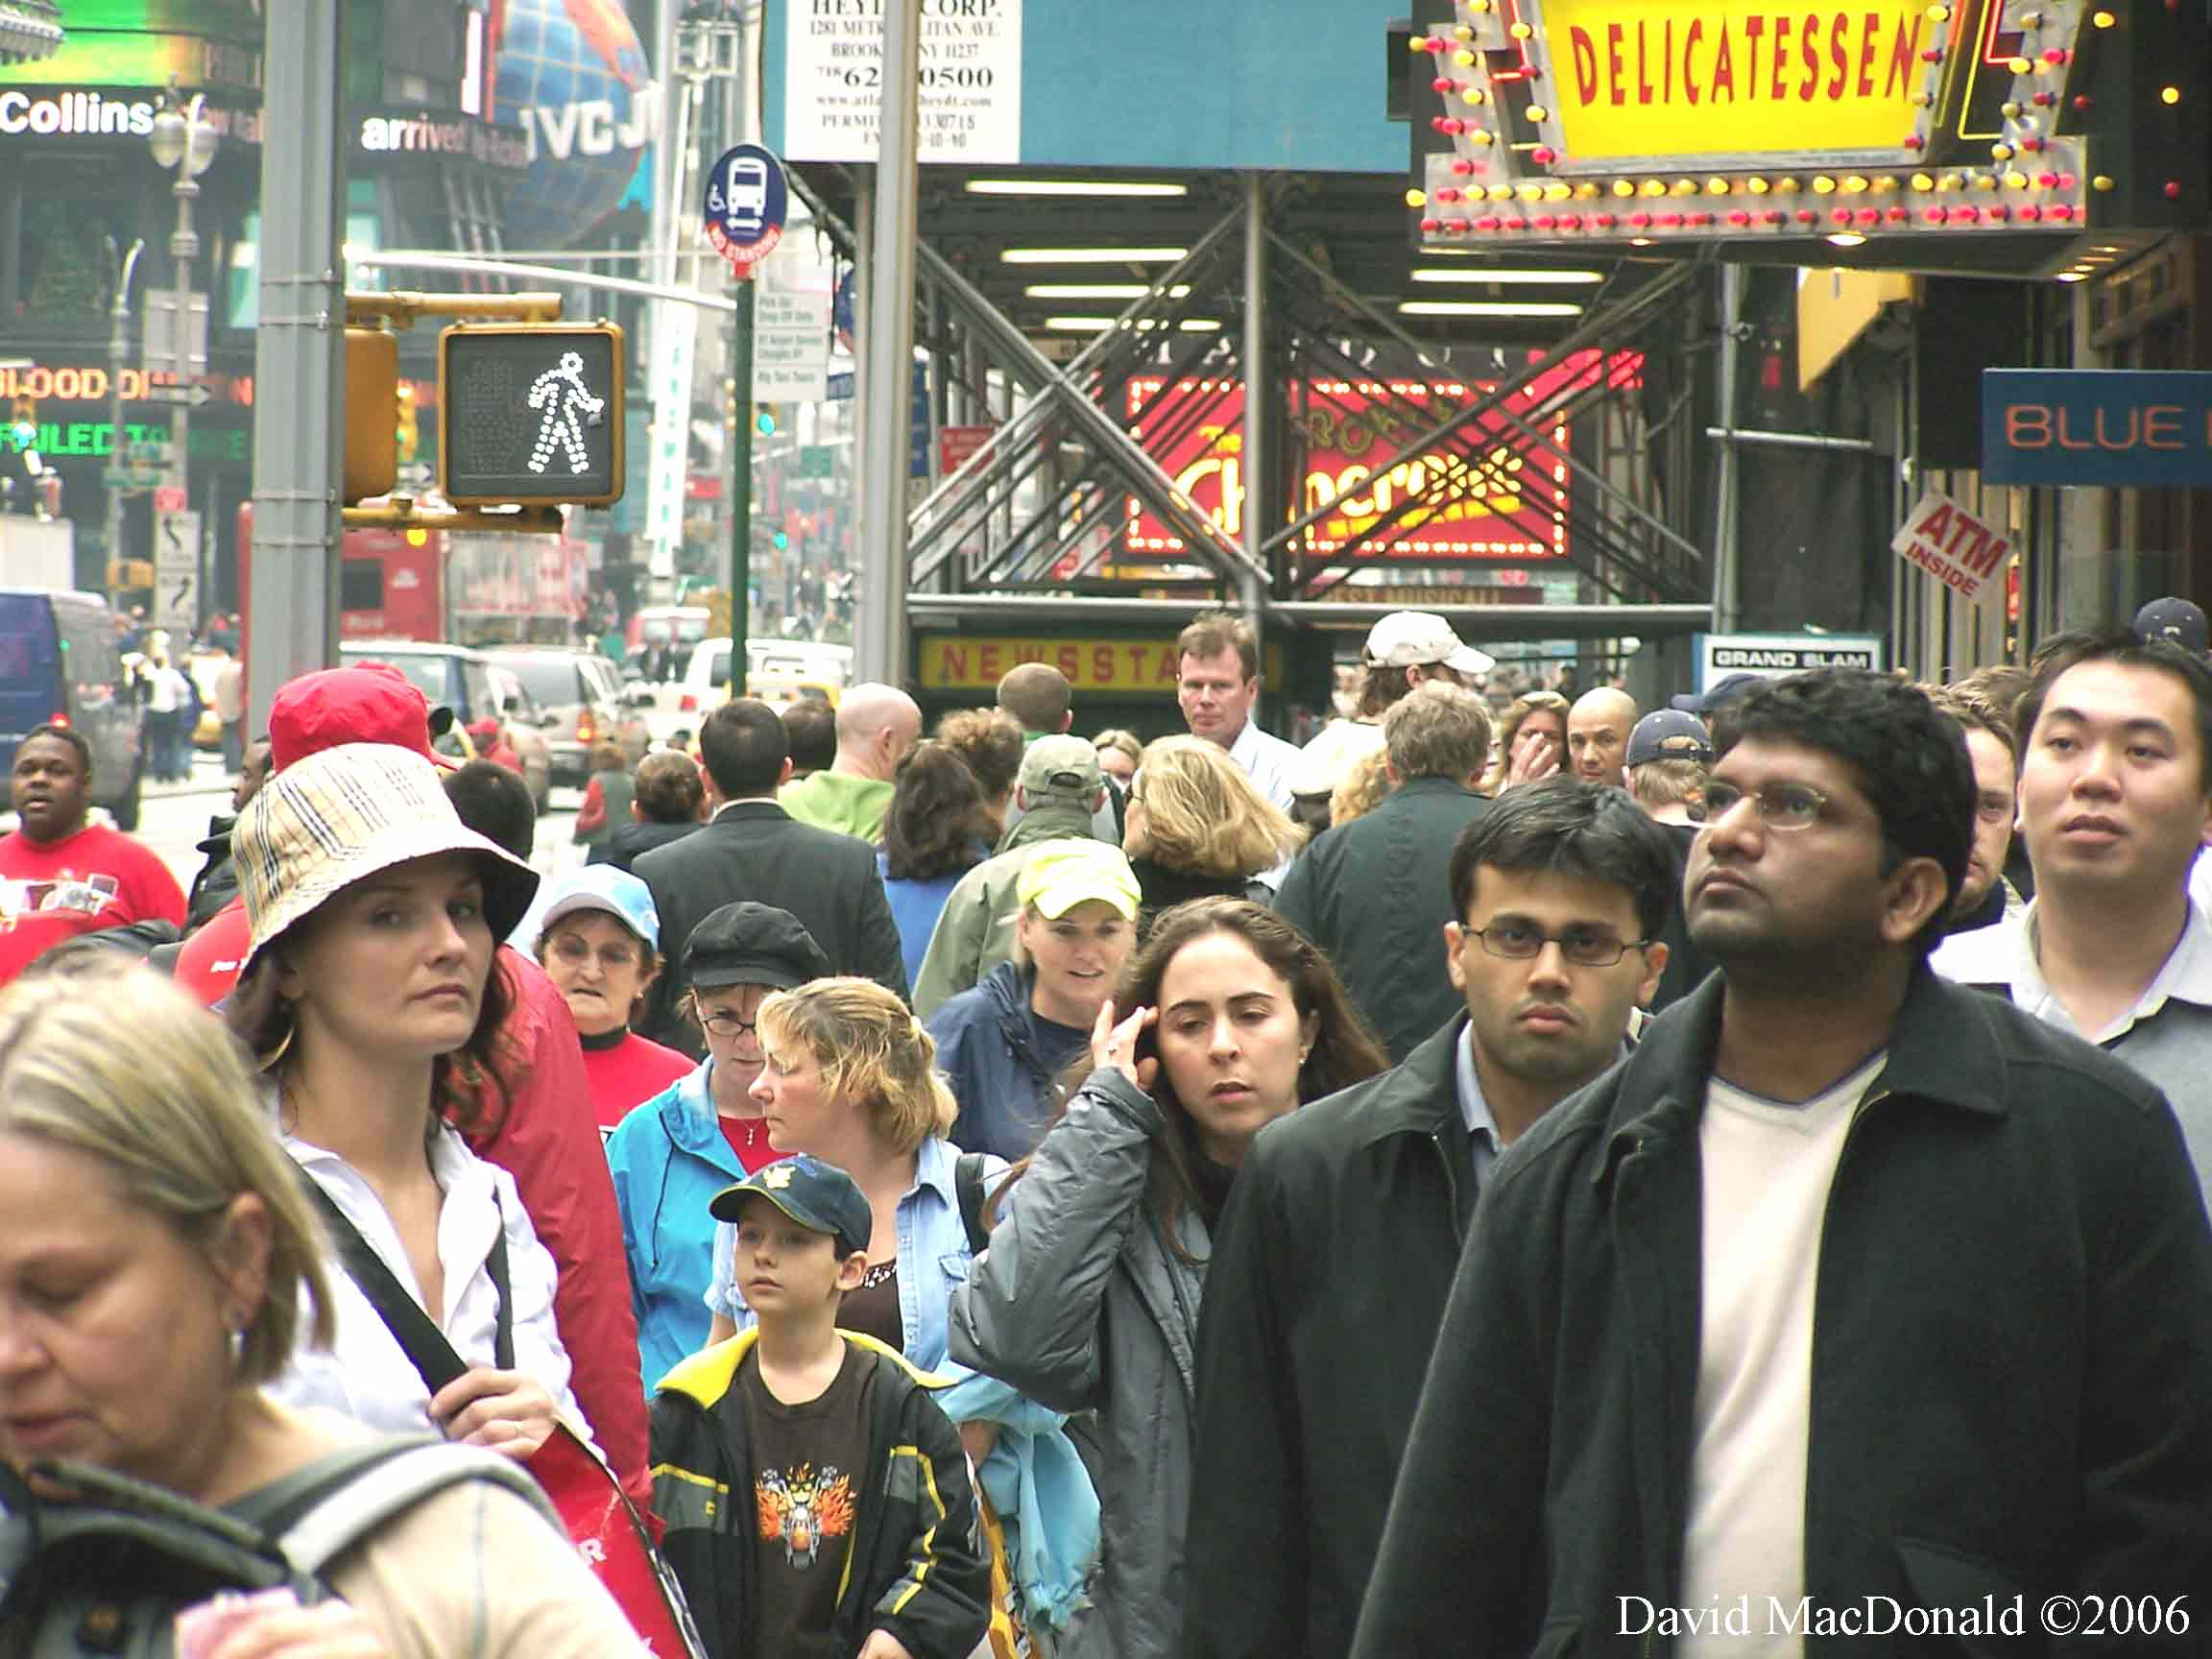
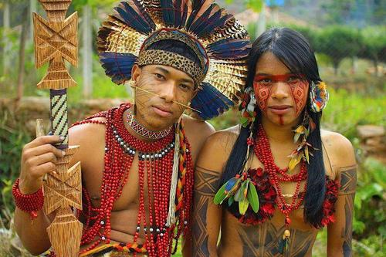
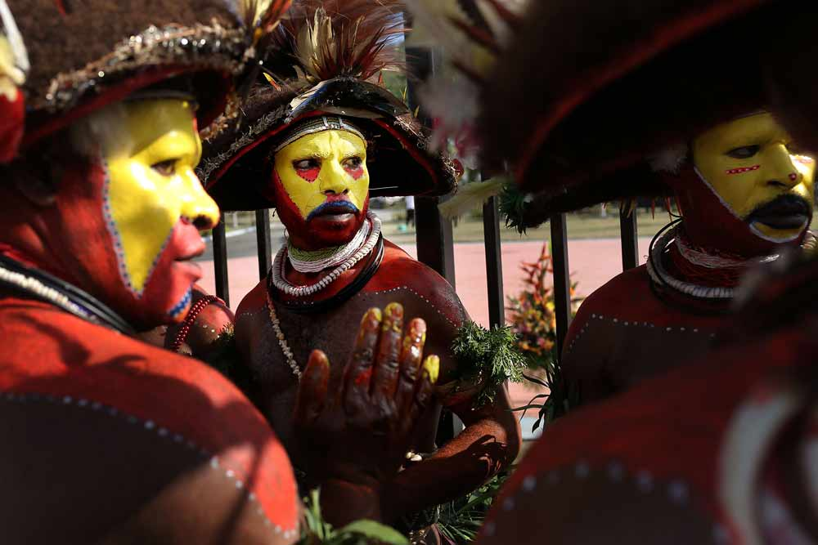
Full of amazing, and different people…

Slide 6
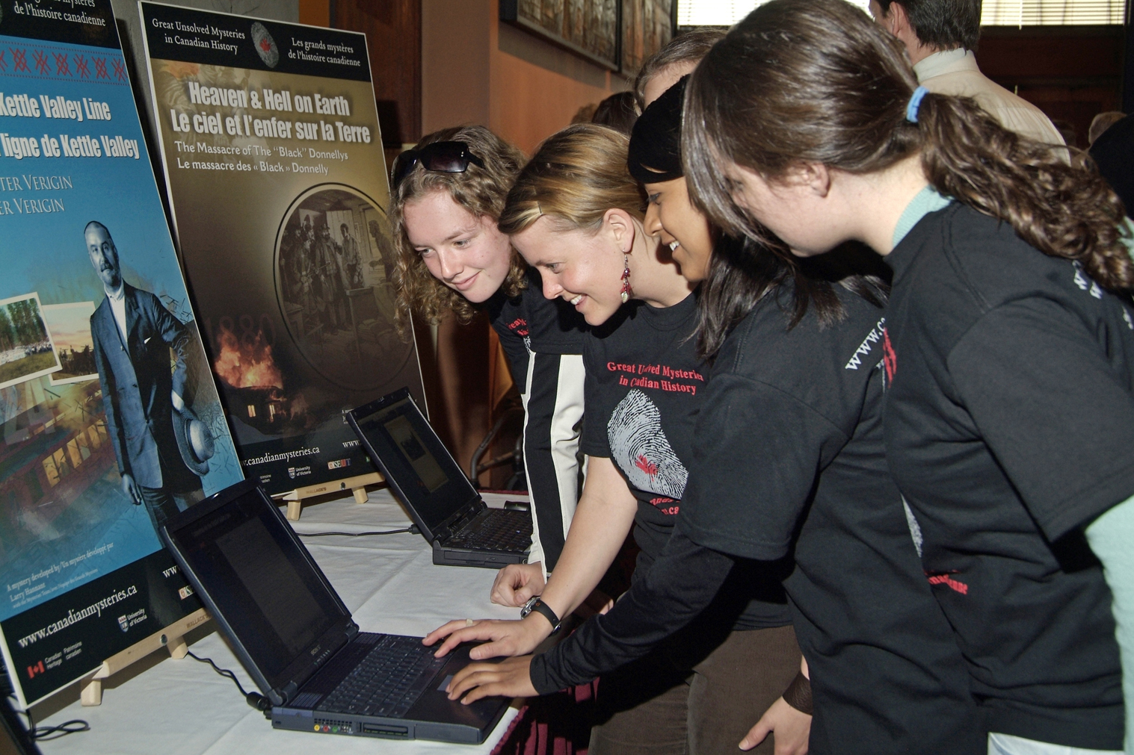
Let’s explore it!

Slide 7
1 Time Period:
500 A.D. to 1500 A.D.
Medieval China + Medieval Japan
The Islamic World + Medieval Africa
The Islamic World + Medieval Africa
500 A.D.
1500 A.D.
2000 A.D.
Europe
Our lives…
We will visit 5 different regions…

Slide 8
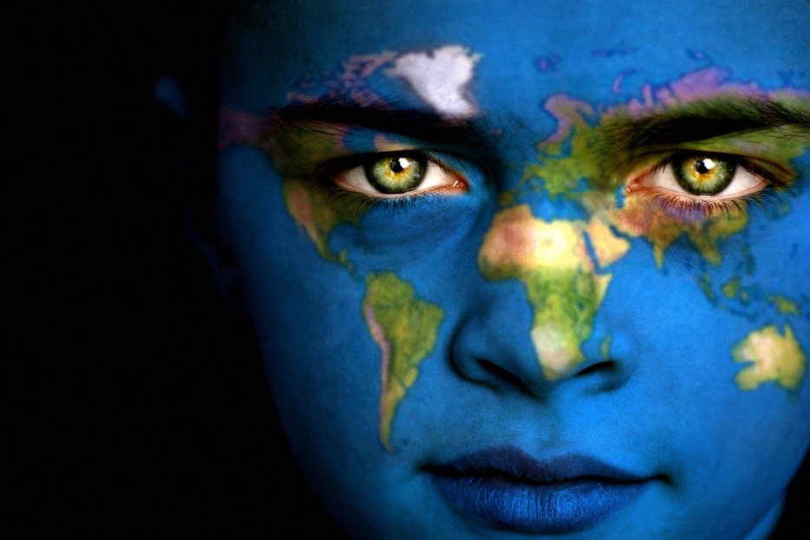
And look at 4 major themes, or ways at looking at history…
Geography
Culture

Slide 9
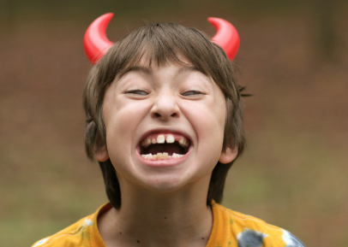
Oh, did I mention that you will be using Ipads in this class… and designing your own personal website? Excited yet…? ☺
Lets get down to the syllabus first.
Class Rules:
Act in a way that will allow yourself and others to learn
In other words, we are here to learn! We want an excellent education because we want the best lives possible, and misbehavior is the best way to prevent you and others from getting that education.
This includes…

Slide 10
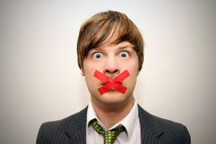
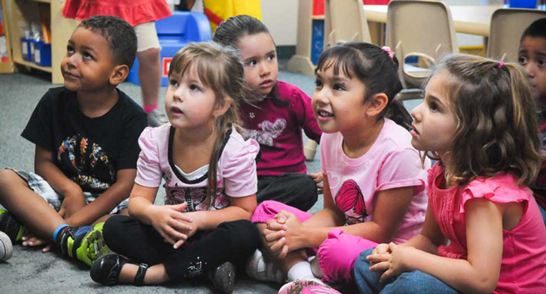
Talking when I am talking… so how will I get your attention?
Talking to another student when I am talking
Talking when you should be doing your work…
Do you notice a pattern? ;)
Other examples include…
Being disrespectful to me or others
Distracting another student in class
Being out of your seat at the wrong time… seriously people this isn’t third grade anymore… ☹
…but Mr. Chapin, I don’t know how
To behave like a student ☹

Slide 11
Rule #2: Use Respectful Words and Body Language
→ If I hear you using a word that I don’t like, you might receive an instant detention. Which words don’t I like?
Try guessing… IN YOUR HEAD. If it sounds like a bad word, I probably don’t like it.
Rule #3: Present your own work… in other words:
Don’t Cheat!

Slide 12
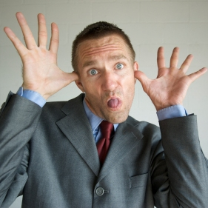
Not meeting my expectations might lower your grade, but they most likely wont lead to a detention.
My 3 goals are based on one basic idea:
If you are not constantly working hard to grow up…
Then everyone else is passing you up…
And nobody likes a grown-up child… ☹

Slide 13
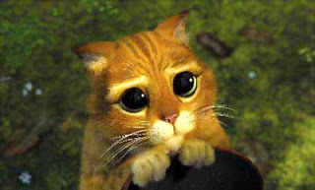
I use a 3 warning system…
1st warning means: check your behavior
2nd warning means: red alert!
3rd warning = After-school detention and call home
I might not ever give warnings! It is very possible for me to give a detention right away. How can mean, evil Mr. Chapin do this to sweet, innocent and nice students?
Because this is my classroom, and I am here to teach you.

Slide 14
Important parts of the classroom:
1. Class Board – shows you the plan for the week and the homework, as well as what skill we are working on at the moment.
Do not confuse the weekly plan with homework for your agenda!!!
2. Class materials (behind U.S. History board) – these are our materials, keep this area neat! You can find scissors, colored pencils, paper, etc. here. I offer a reward for students that tell me about any other student taking materials from the class.
3. ipads – we will talk about this later…
4. News Board – contains important information, below you will find: extension and absent turn-in forms, extra handouts, and late turn-in boxes
5. Student work boards
→ Why should you respect all your classrooms?

Slide 15
Assignments:
→ YOU ARE RESPONSIBLE FOR YOUR ASSIGNMENTS AND TEST DATES!
I know you have 4 core subjects, and it can be a lot to juggle.
USE YOUR AGENDA… good students do.
→ 2 Day Passes
TALK TO ME!
Yes, my tests are hard, but this year you will have a chance to plan your success…
Set a goal and achieve it. Getting a B is better than shooting for an A and getting a D…

Slide 16
Signed Syllabus is due WEDNESDAY!!! And it’s your first assignment… what kind of a first impression do you want to make?
Other notes:
Class website: chaptopia.weebly.com
We will be using My Big Campus this year (and there will be a lot of technology!) ☺

